Slide 1
Study Skills
Effective Reading

Slide 2
Are you a ‘good reader’?
The WRITTEN word – all around us
Books
Newspapers
Cards and Letters
Instruction Manuals
Road signs
Advertising
Packaging
Junkmail
‘Fliers’

Slide 3
Effective Reading is about…
… finding the right way to read
… depending on your purpose
.. and the nature of the text

Slide 4
Different reading strategies for different situations
1. Scanning
2. Skimming
3. Normal Reading
4. Close Reading

Slide 5
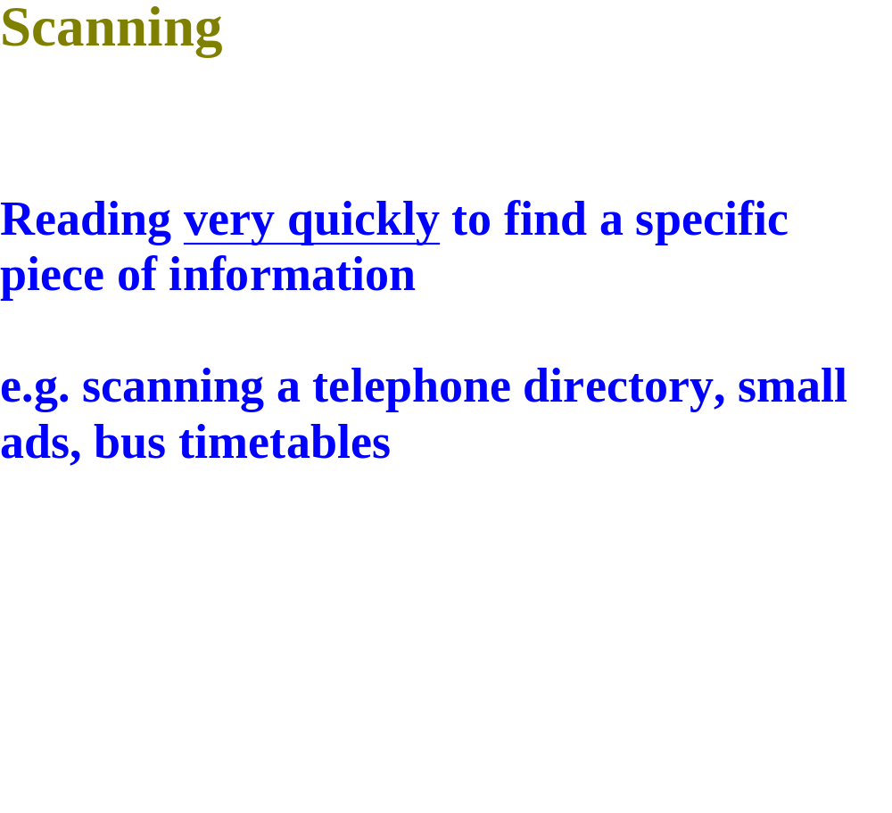

Slide 6
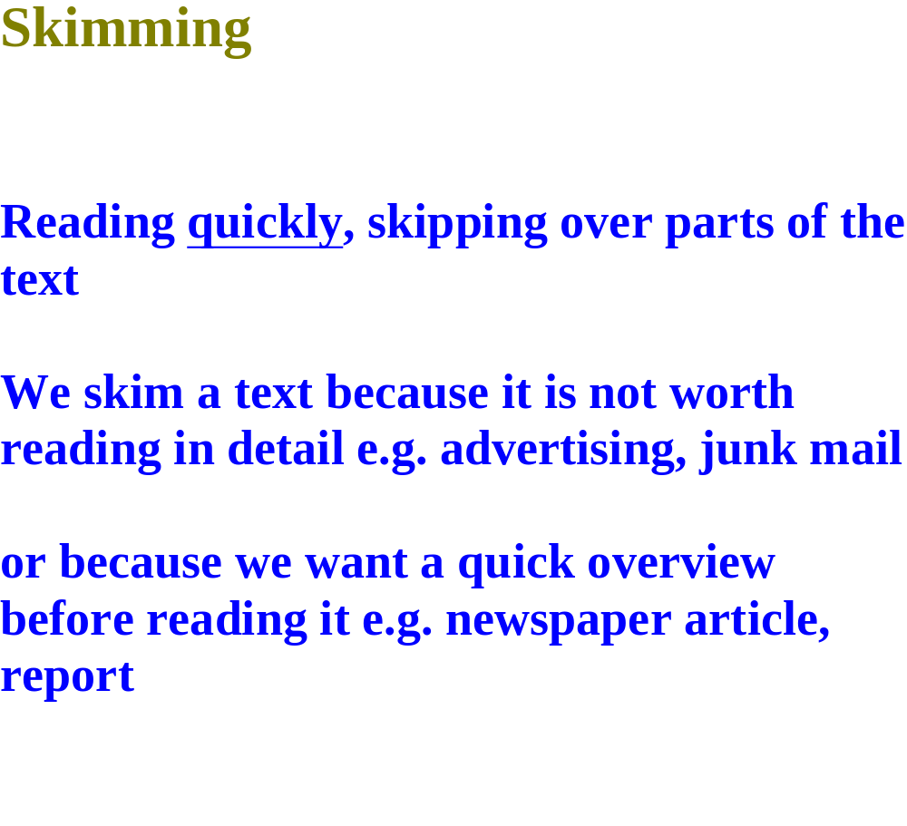

Slide 7
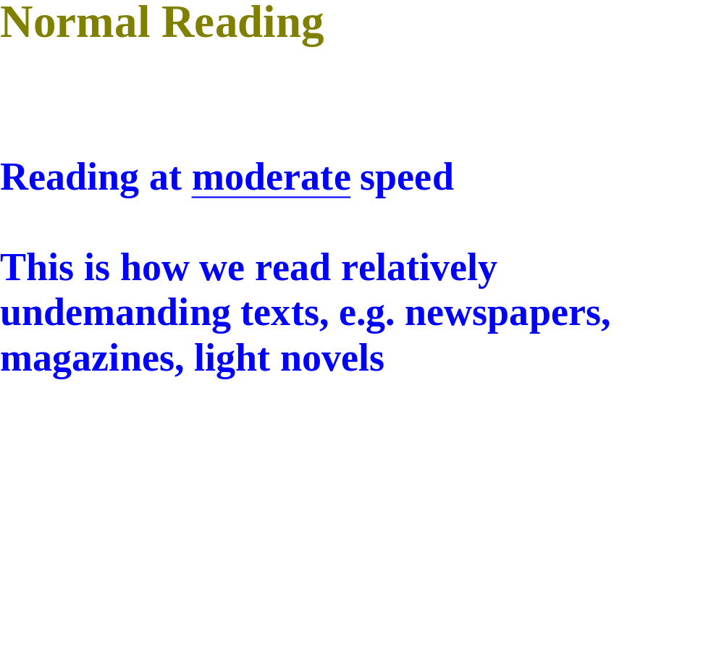

Slide 8
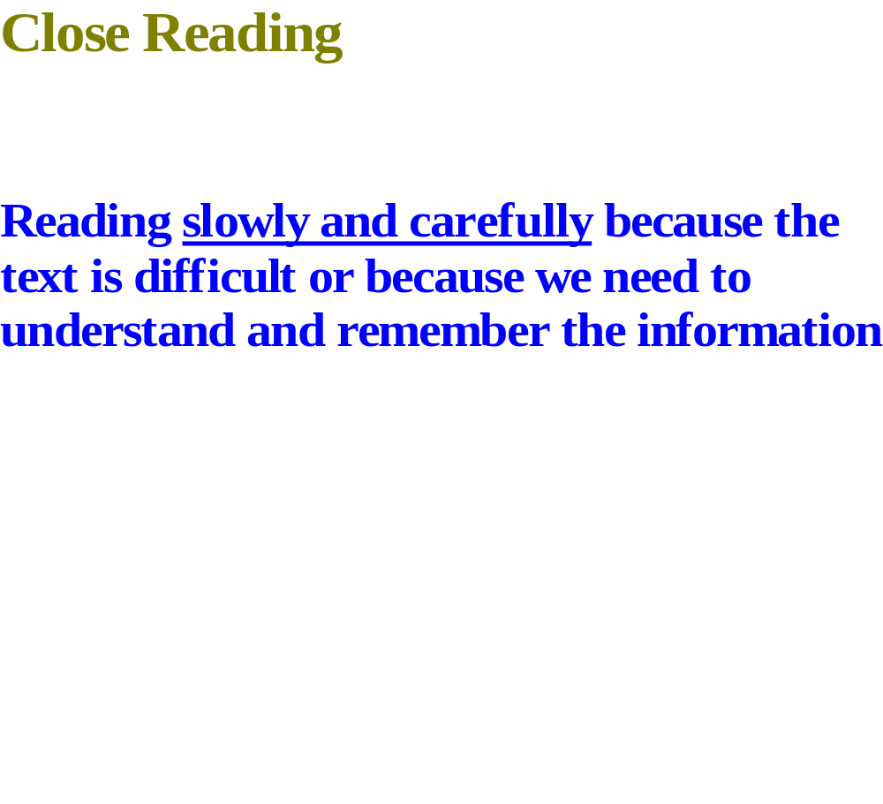

Slide 9
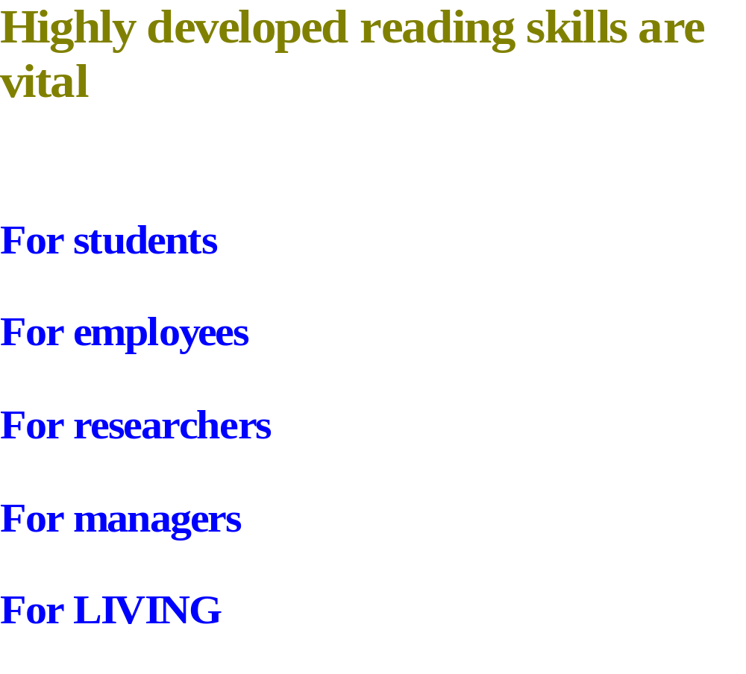

Slide 10
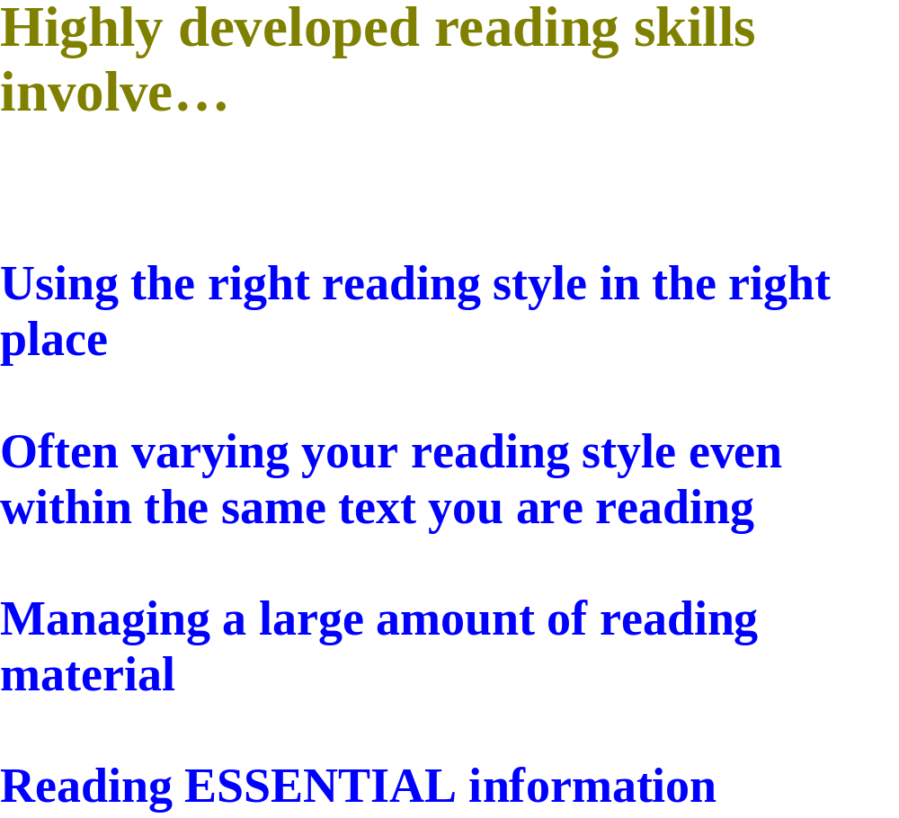

Slide 11
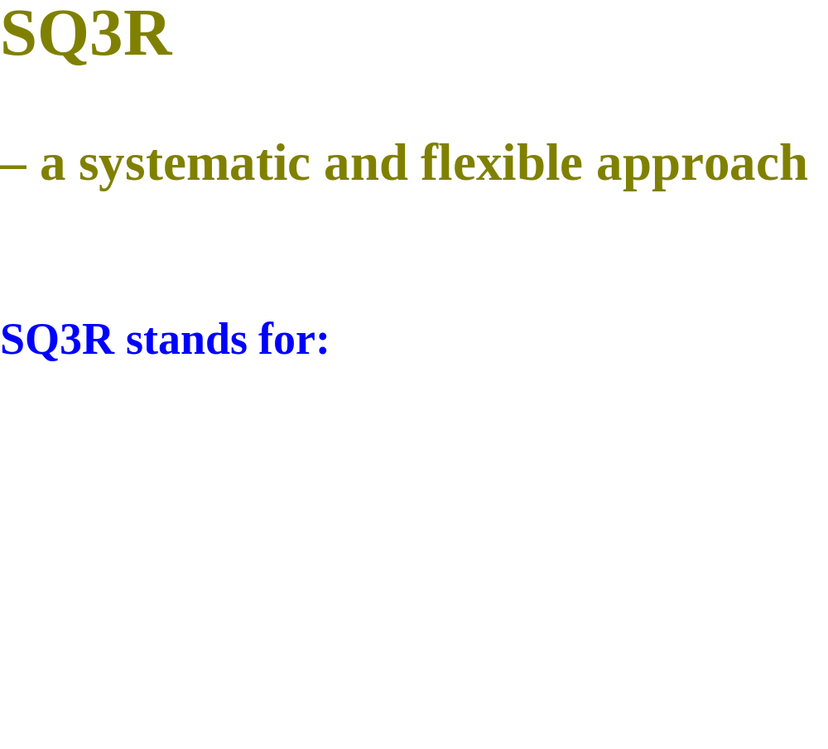

Slide 12
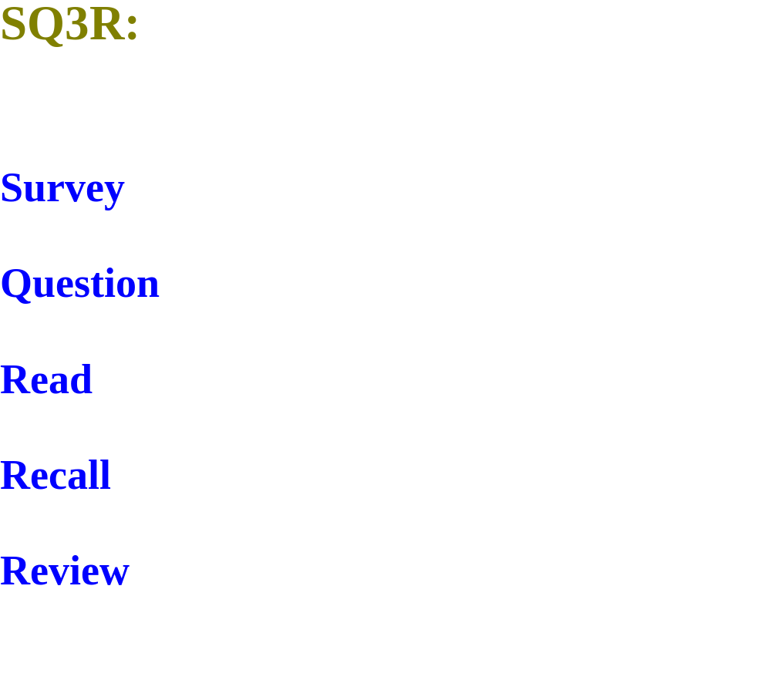

Slide 13
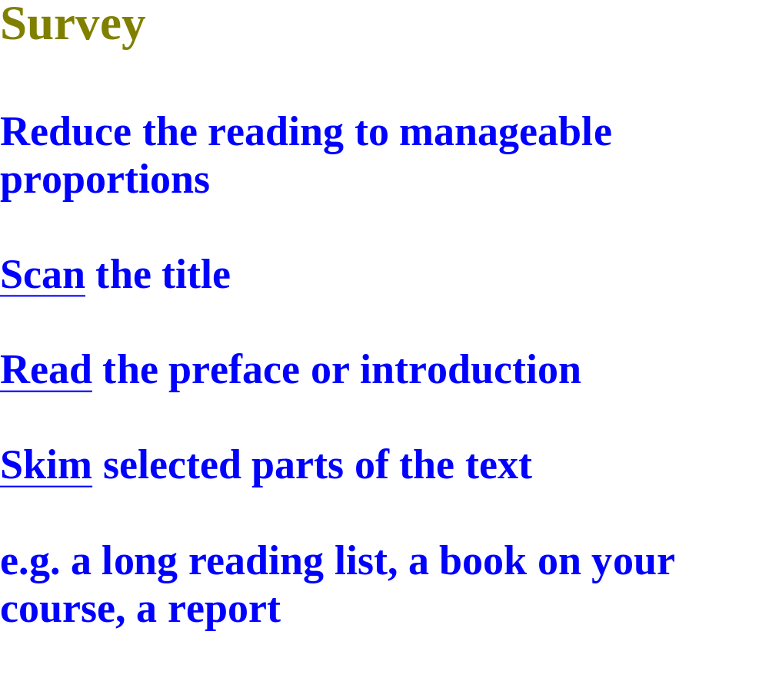

Slide 14
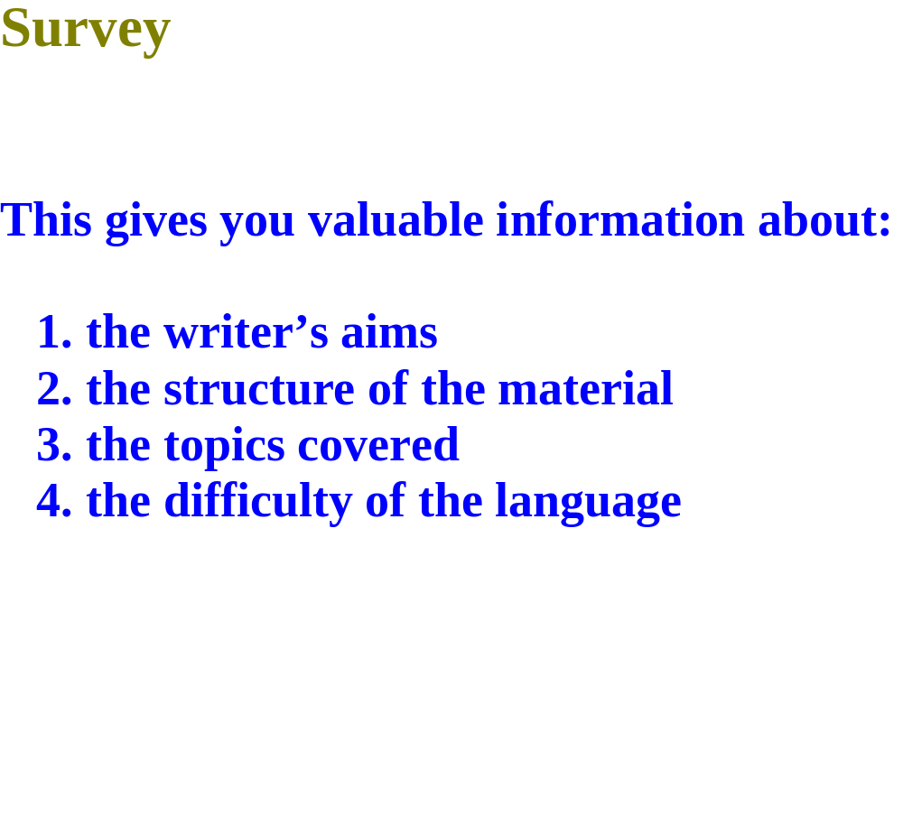

Slide 15
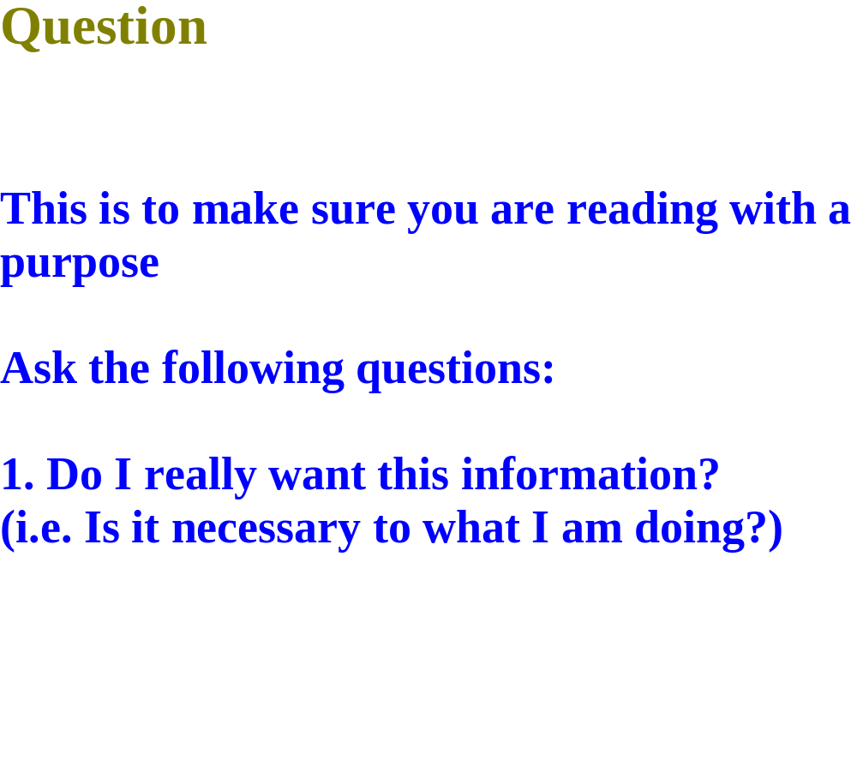

Slide 16
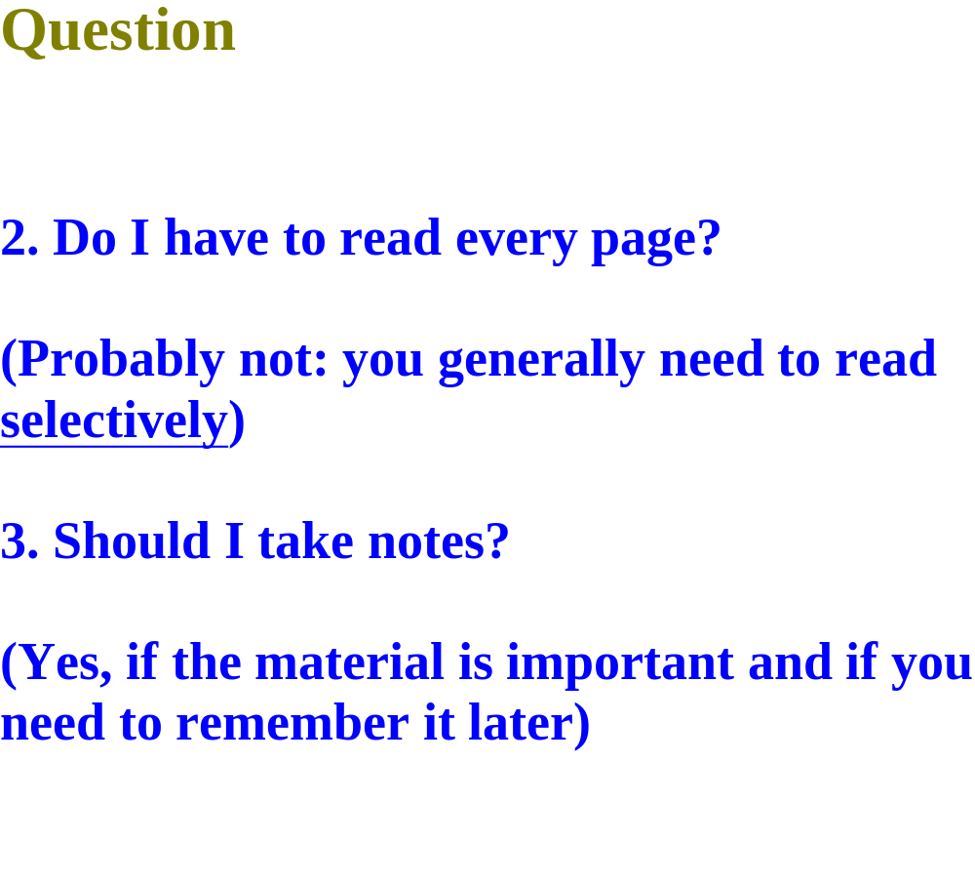

Slide 17
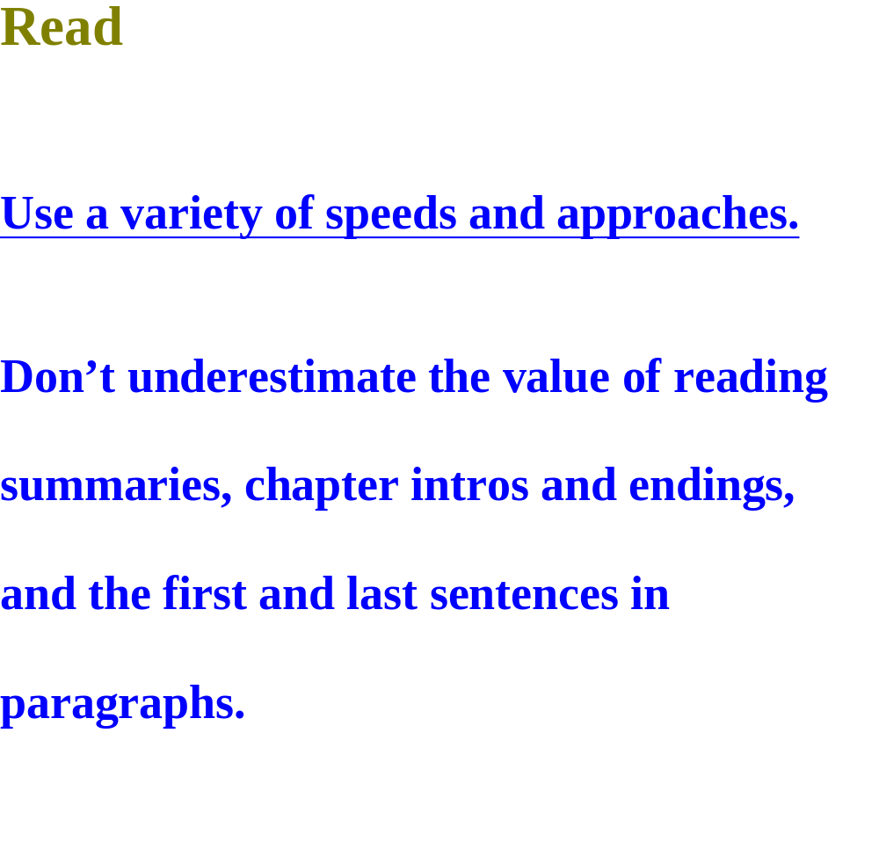

Slide 18
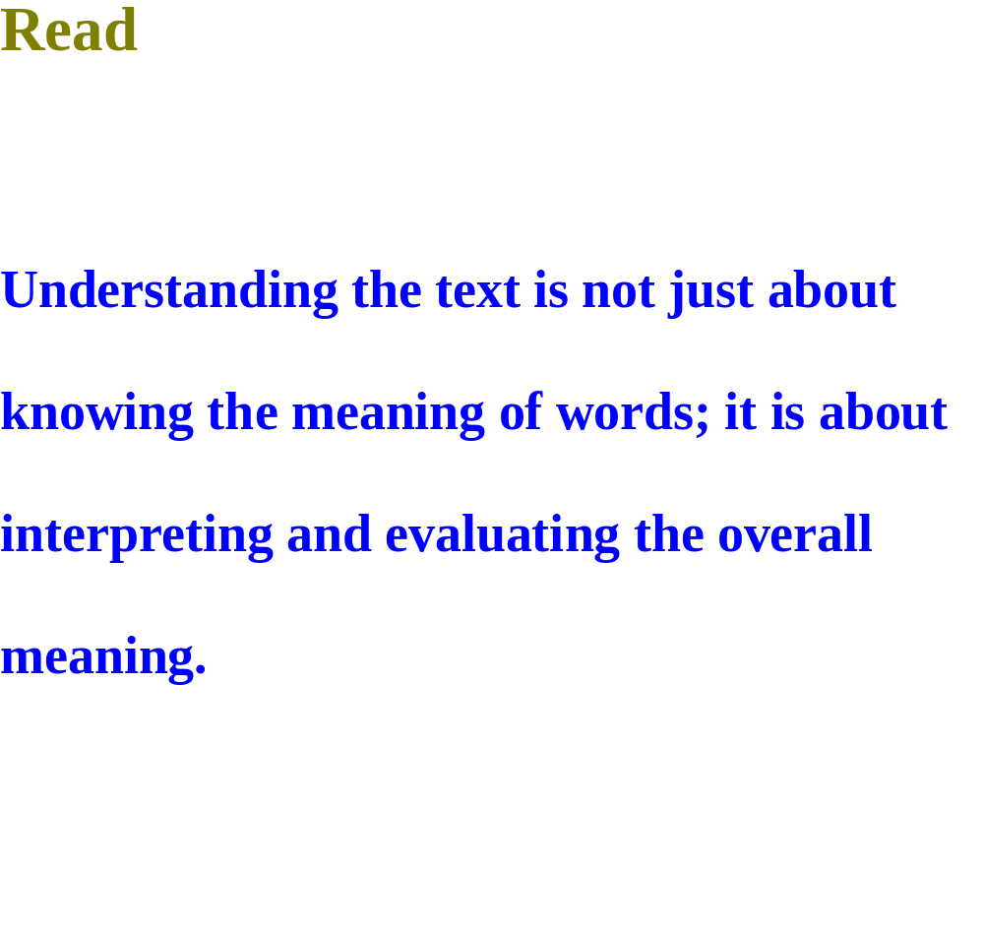

Slide 19
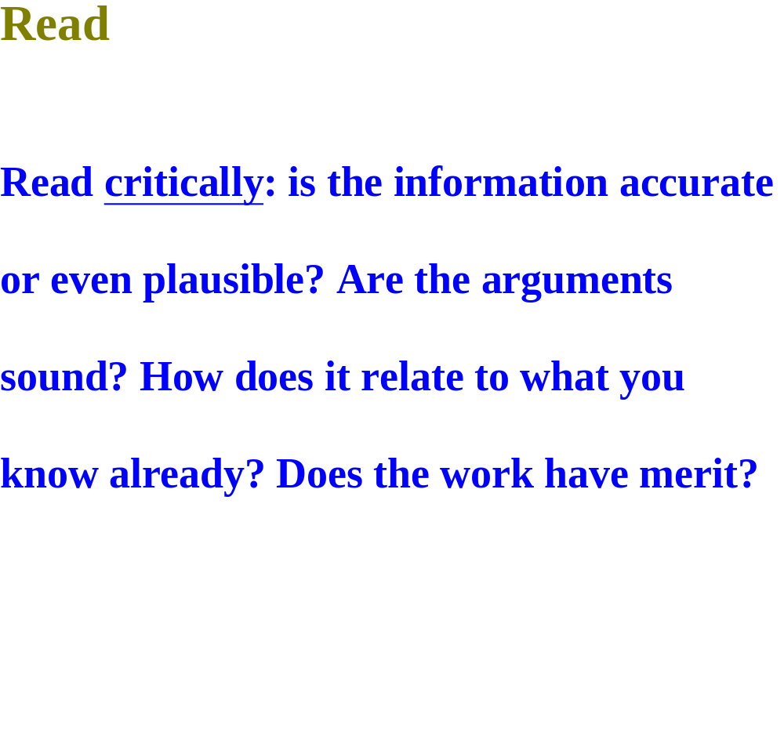

Slide 20
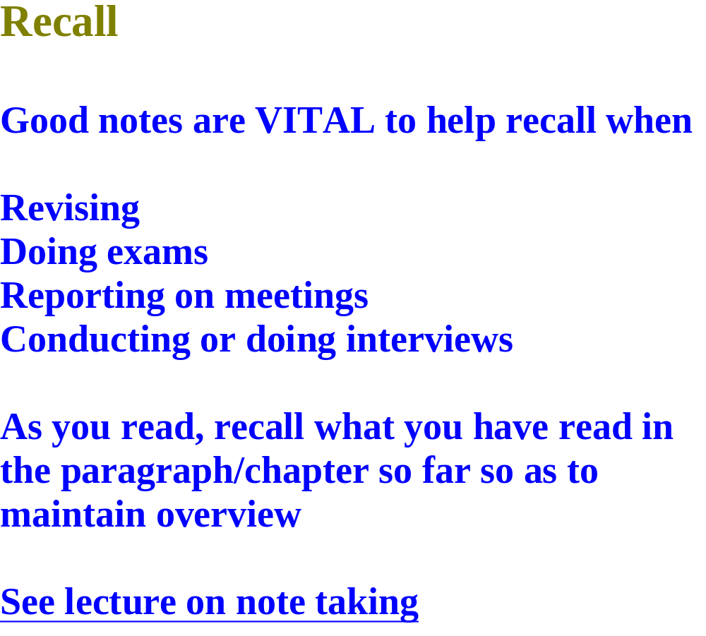

Slide 21
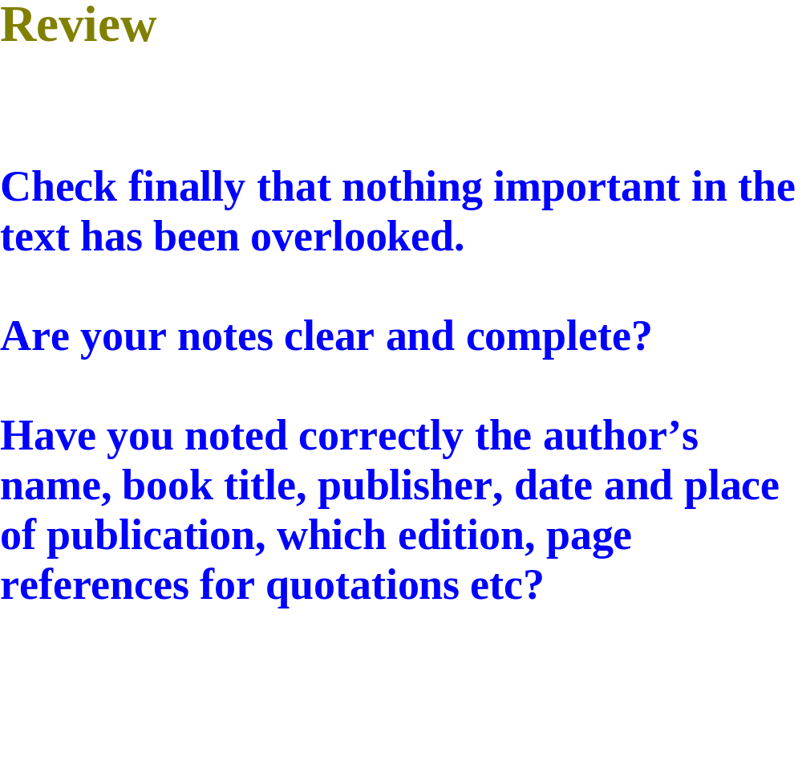

Slide 22
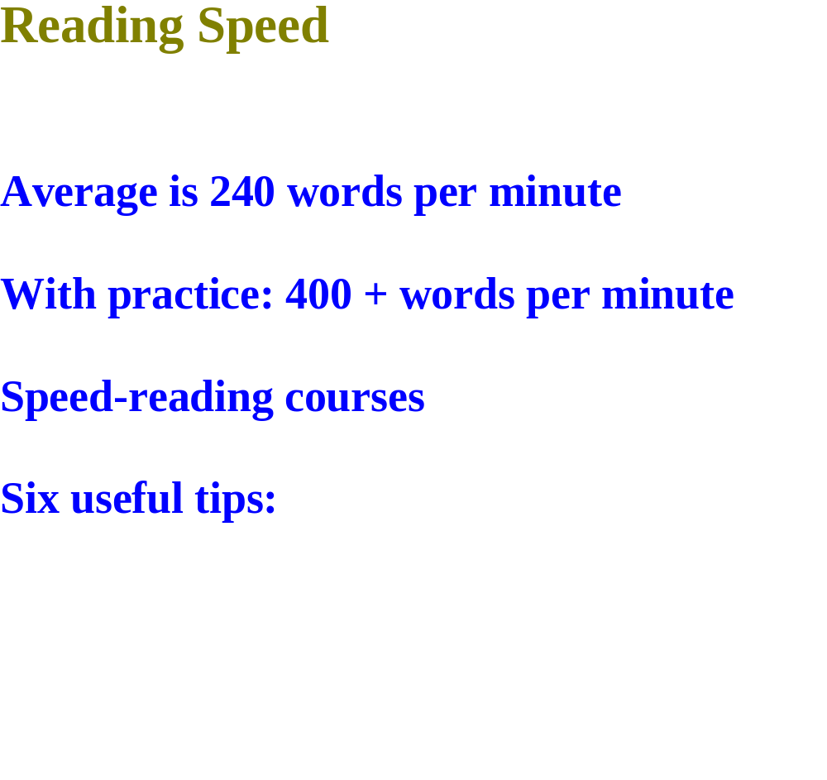

Slide 23
